Slide 1
11- How Python Code is Executed

Slide 2
Context
Machine code 3
Compiler 4
Machine code is specific to the type of CPU of a computer 5
Java 6
Cpython 8
Jython 9

Slide 3
Machine code
The programming languages we use, like C, C#, Java, Python, these are all simple text based languages that we humans understand,
computers don't understand them, they only understand machine code.

Slide 4
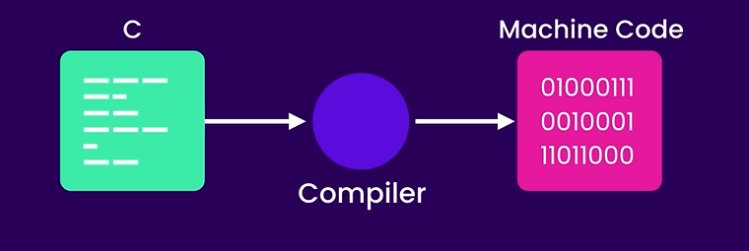
Compiler
So if you have some code written in C, we should convert it to machine code, and that's the job of a C Compiler.
So a C compiler is a program that knows how to convert or compile C code into machine code.

Slide 5
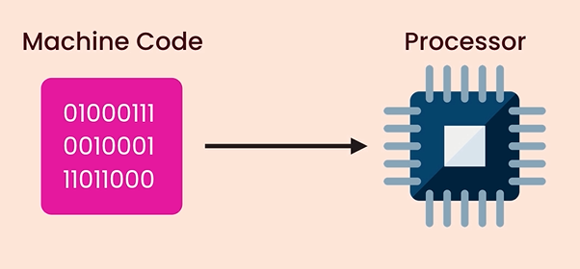
Machine code is specific to the type of CPU of a computer
so if you compile a C program on a Windows machine we can’t execute it on a Mac, because Windows and Mac have different machine code, just like how people from different countries speak different languages.

Slide 6
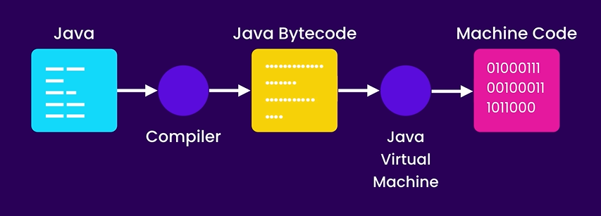
Java came to solve this problem. Java compiler doesn’t compile Java code into machine code, instead it compiles it into a portable language called JavaBytecode. Which is not specific to a hardware platform like Windows or Mac.
Now, we still need to convert Java Bytecode to machine code. So Java also comes with a program called Java virtual machine or JVM for doing this.
When we run a Java program, JVM kicks in, it loads a Java ByteCode and then at run time, it will convert each instruction to machine code.
With this model, we can run Java Bytecode on any platforms that have a JVM.

Slide 7
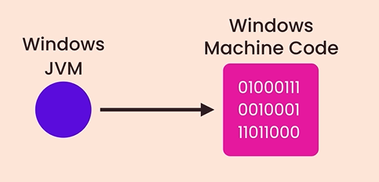
We have JVM implementations for Windows, Mac, and so on. So the JVM implementations on Windows, knows how to convert Java Bytecode into machine code that a Windows machine can understand.
C# and Python have also taken the same route so they are platform independent

Slide 8
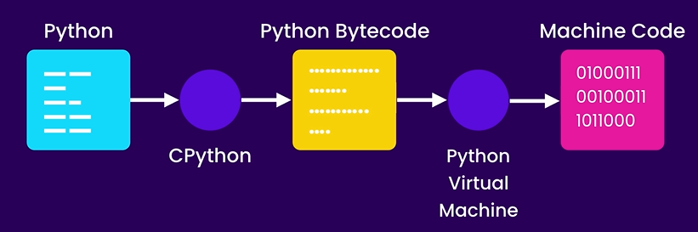
When we run a python program using C Python first it will compile our Python code into Python ByteCode, then it will pass that Bytecode to Python Virtual Machine which will in turn convert it into machine code and execute it. This is how C Python works.

Slide 9
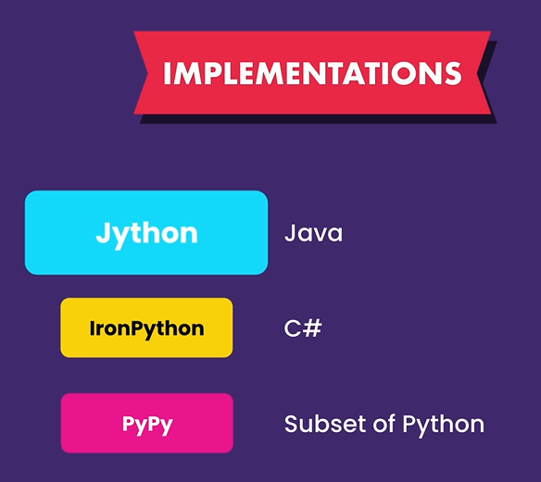
In the last lecture we talked about various Python implementations. I told you that if you wanna reuse some Java code in a Python program we should use Jython. Now, let's see how Jython makes this possible.

Slide 10
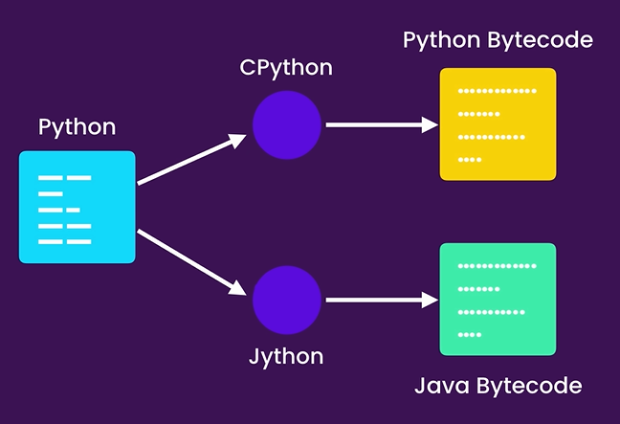
When you use Jython to run a python program, instead of compiling your Python code into Python Bytecode, it will compile it to Java Bytecode,
so we can take this Java Bytecode and run it using Java virtual machine.
And that's why we can import some Java code into a Python program when using Jython, because the end result is Java Bytecode which will eventually be executed by Java virtual

